Slide 1
Automoblox Comparison
Iwin Yeung

Slide 2
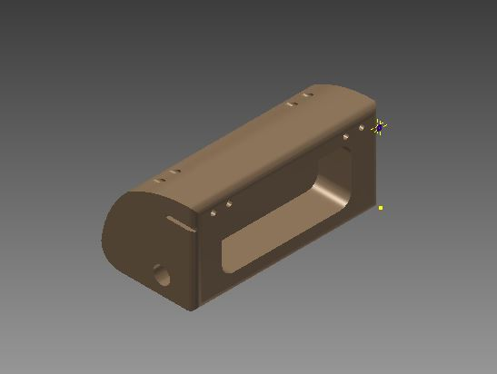
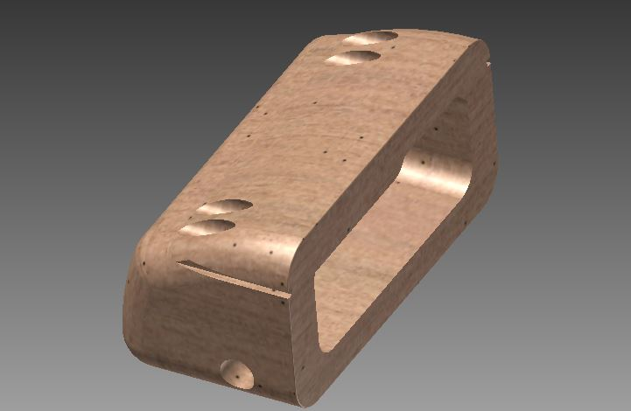
Front
The differences between the front I drew and the actual front is the color and the roundness of the front. The actual front has a three corner roundness, whereas, my front is more rigid. In order to draw the front I first drew the semi-circle shape and then extruded it backwards. After that, I began to apply details to the front piece.

Slide 3
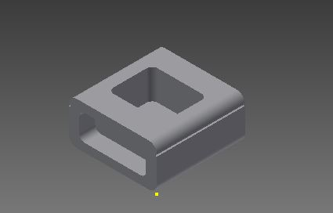
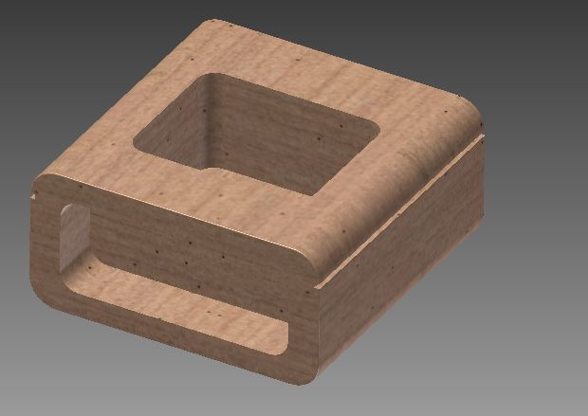
Body
The body piece resembles the actual piece in terms of the shape; only the color differs. I began to draw this piece by making a rectangle and rounding the edges before extrusion.

Slide 4
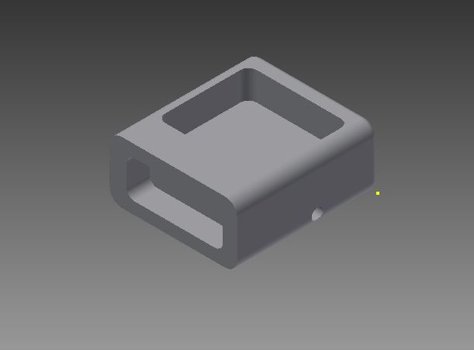
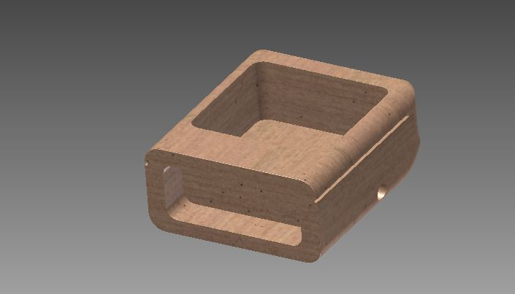
Back
The back piece that I created is similar to the actual back piece.One of the main differences may be that the back has a more rounded shape compared to my rounded, but shaper edge back. In order to create the back, I first made the rectangle and extruded back. Then I rounded the edges and made the rectangular sketch on top and extruded down. Then I made the holes and a smaller rectangle on the sides for the connector pieces.

Slide 5
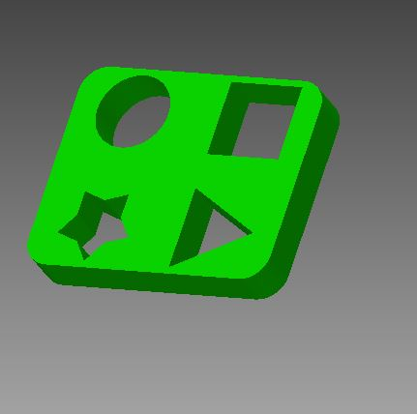
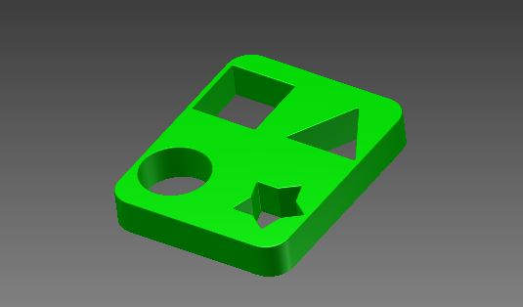
Passenger Base
The passenger base highly resembles the actual part; there may not be a difference between the two pieces. Everything is identical between the two. In order to make the passenger base, I first made the square with rounded edges.Then I made the four shapes and then extruded the out.

Slide 6
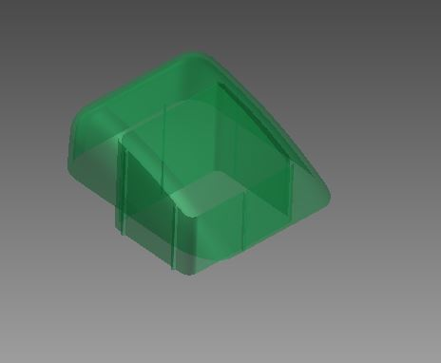
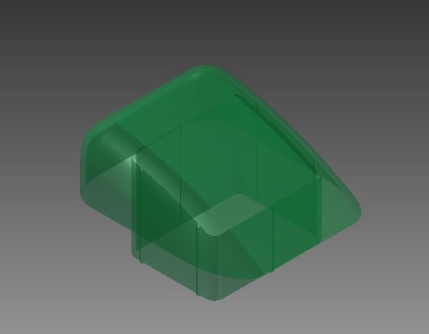
Windshield
The windshield I made in inventor and the actual windshield are relatively identical. Most if not all features are present in the windshield that I built. In order to construct the windshield, I first made the side shape of a right triangle shape. Then I extruded it back and rounded the edges. Finally, I began the design on the bottom by making a square-rounded shape and extruding it out.

Slide 7
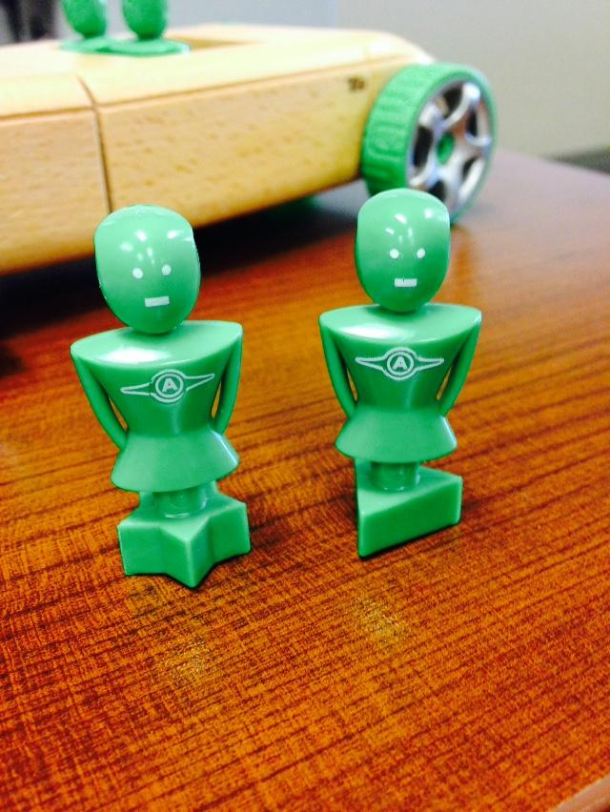
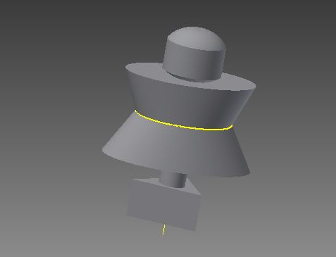
Girl
The girl I created is somewhat similar to the actual part; the difference is the shapes in the middle and head piece. To begin the creation of the girl, I first made the triangular base. Then, I made layers and layers stacking on top of each other. The loft tool was utilized in creating the body. To create the head, I made a quarter head sketch in the first quadrant of the circle, then used the rotation to to develop the head in 3D.

Slide 8
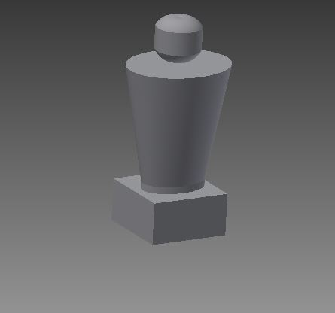
Male
The male I created in inventor is similar to the actual male. I only difference may be the middle body of the people. In order to create the male in inventor, I first made the square base. Then, I created planes and used to loft tool to make the gradual increase of the ellipse up to the top. Then I made a quarter-head in the first quadrant of the ellipse and used the rotation tool to make the 3D head.

Slide 9
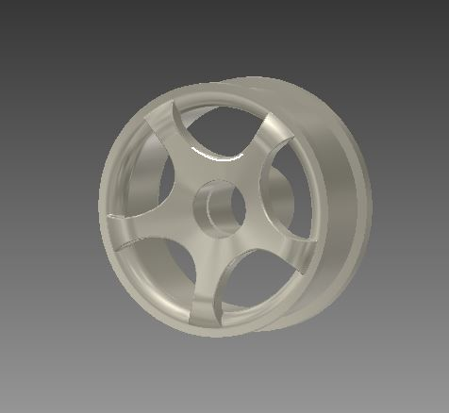
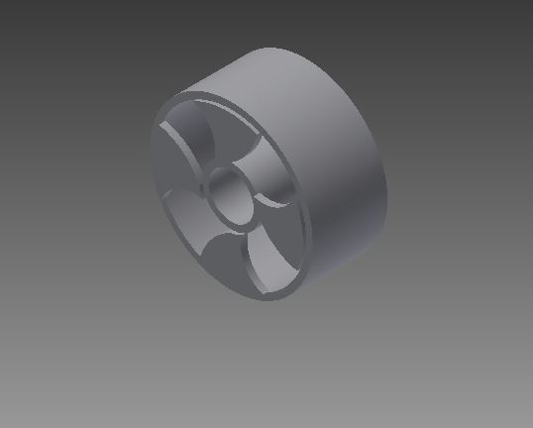
Wheel
The wheel is somewhat similar in terms of the structure. The only difference is the pattern on the outside ring. In order to make this wheel, I first made the 3 circles and extruded them accordingly to the picture above. Afterward, I made a pattern by connecting the outer circle to the inner circle and used the circular pattern tool for the final shape.During this part, I learned to use the circular tool.

